Slide 1
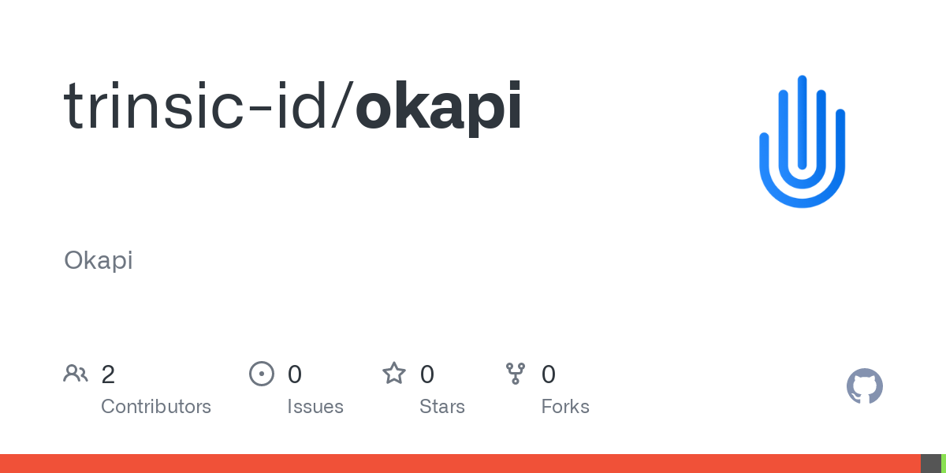
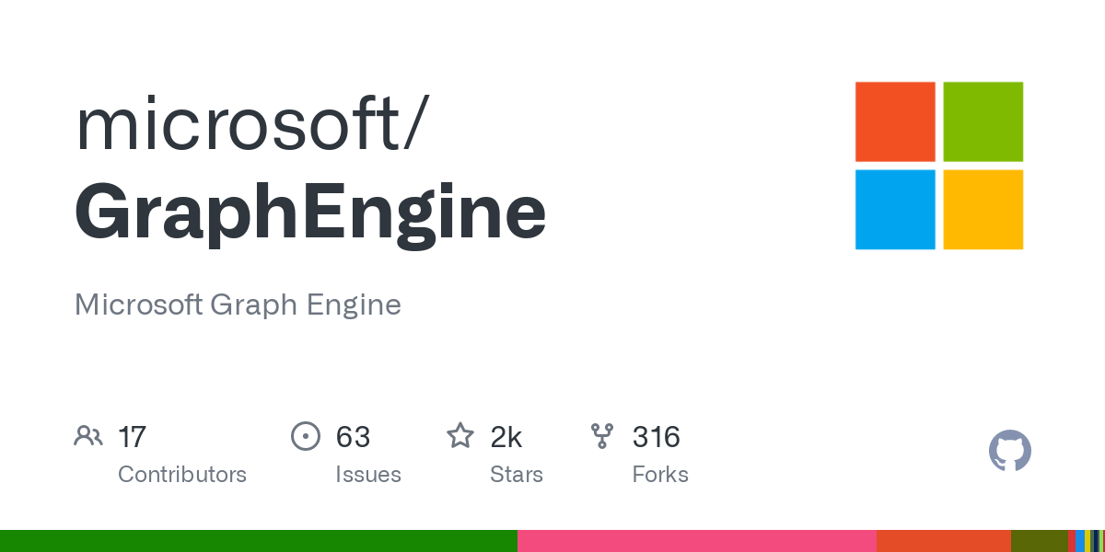
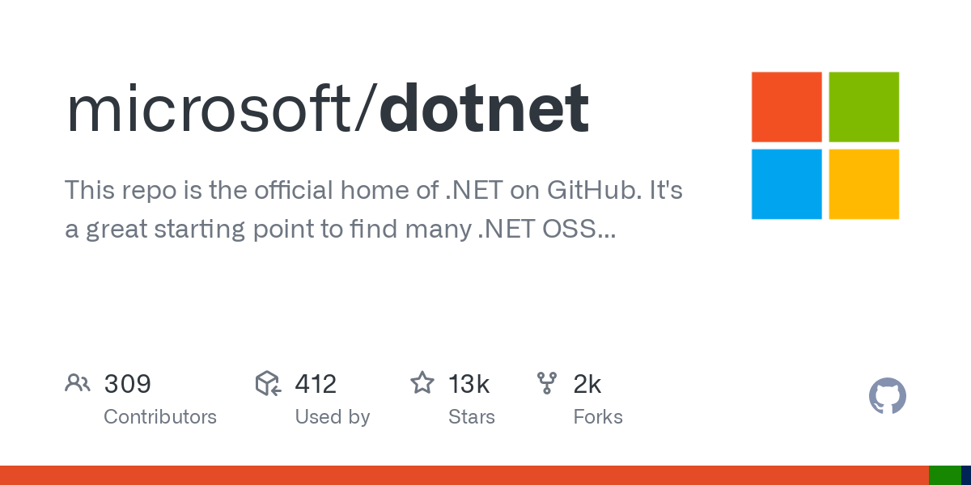

DIDCOMM Super Stack (DIDSS) Creating highly scalable DIDCOMM Agents using .NET, Trinity, and Okapi with Ease (Ft. VCTPS Protocol)
Michael Herman Trusted Digital Web Project Hyperonomy Digital Identity Lab Parallelspace Corporation Alberta, CANADA
mwherman@parallelspace.net
Copyright (c) 2022-2023 Michael Herman (Alberta, Canada) - Creative Commons Attribution-ShareAlike 4.0 International Public License

Slide 2
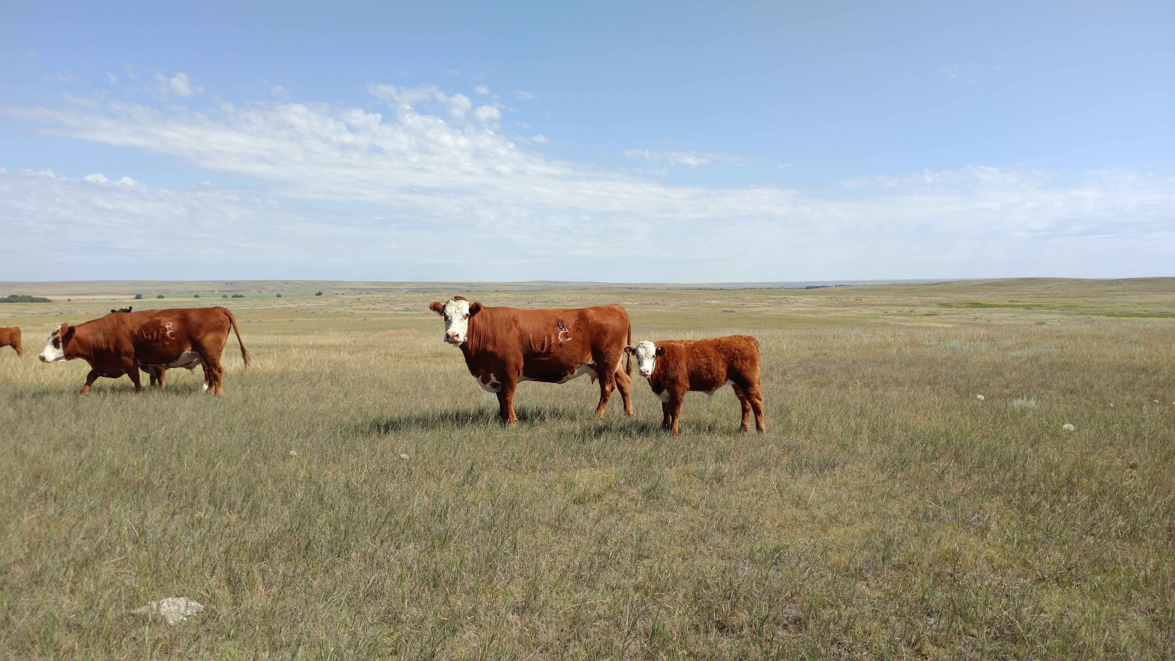
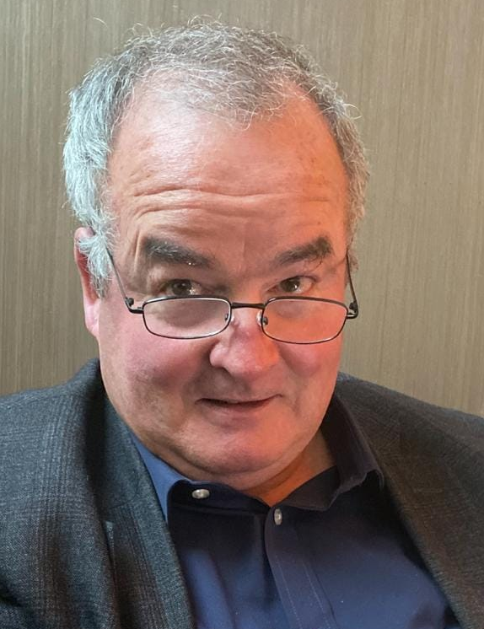
Michael Herman Self-Sovereign Blockchain Architect and Developer Hyperonomy Digital Identity Lab Parallelspace Corporation Alberta, CANADA
2

Slide 3

SINGULAR Goal
Making decentralized agent design and development easier for C# and .NET developers
Model-based Automatic Code Generation
Structured Credential Model
Trinsic DID and DIDCOMM Libraries

Slide 4
Agenda
DIDCOMM Super Stack (DIDSS)
Microsoft “Trinity” GraphEngine
Trinsic-id Okapi DID Library
Microsoft .Net Platform
Secure Verifiable Credential Transport Protocol (VCTPS)
Structured Credential Model
Lots of Demos
Resources
Q&A

Slide 5
DIDCOMM Super Stack (DIDSS)
Application framework for creating Verifiable Capability Authorization-enabled, highly scalable decentralized agents using .NET and DIDCOMM (featuring the VCTPS DIDCOMM Protocol)
Requirement | Open Source Project
3. DID key generation, DIDCOMM messaging, and credential signing | Trinsic-id Okapi Library
2. Decentralized agent modeling and code generation | Microsoft “Trinity” GraphEngine
1. Development and execution platform | Microsoft .NET Platform

Slide 6
 Microsoft “Trinity” GraphEngine
Decentralized agent modeling and code generation

Slide 7
Microsoft “Trinity” GraphEngine
Trinity Specification Language (TSL)
Agent protocol and message structure definition
TSL Codegen
Automatic code generation of complete C# projects
Objects, messages, and message handlers
Automatic JSON serialization/deserialization
Very fast, highly optimized in-memory object graph database
Highly performant and scalable clustered deployment model
Simple, easy and efficient to use

Slide 8
 Trinsic-id Okapi
DID key generation, DIDCOMM messaging, and credential signing

Slide 9
Trinsic-id OKAPI API
DIDKey
generate
resolve
DIDCOMM
pack
unpack
sign
verify
Oberon
create_key
create_token
blind_token
unblind_token
create_proof
verify_proof

Slide 10
 Microsoft .Net
Development and execution platform

Slide 11
Microsoft .NET Platform
Build and execution platform
Visual Studio 2022 IDE
Visual Studio Code w/GitHub integration
C# version 10
Microsoft Common Language Runtime (MSCLR)

Slide 12




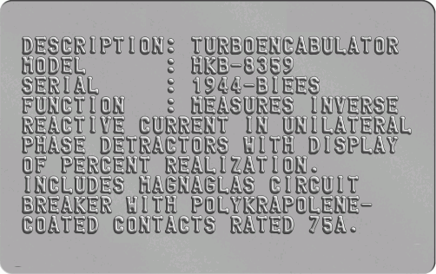
What is a Structured Credential? Credential Envelope Credential Content Packing Label Envelope Seal

Slide 13

Credential Envelope
(with ID)

Slide 14
Credential Envelope
(with ID)
Credential Content
[ID + Claims]

Slide 15
Credential Envelope
(with ID)
Credential Content
[ID + Claims]
Packing
Label
(Metadata)

Slide 17
Credential Envelope
(with ID)

Slide 18
Credential Envelope
(with ID)
Packing
Label
(Metadata)

Slide 19
Credential Envelope
(with ID)
Envelope
Seal
(Proof)
Sealed Envelope
Packing
Label
(Metadata)

Slide 20
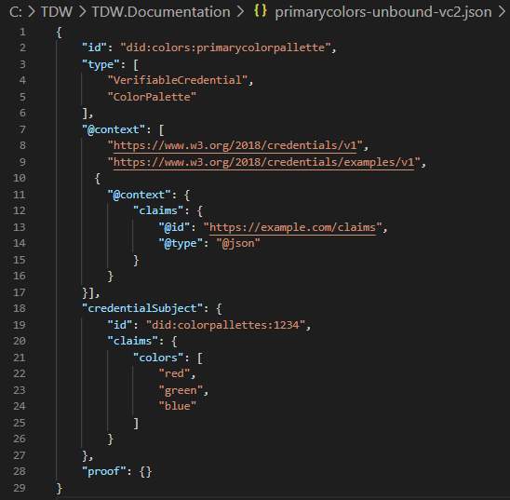
Primary Colors: Bound Credential Example
Credential Envelope
Packing Label
Credential Content
Claims
Envelope Seal

Slide 21
struct BTT_Invoice_EnvelopeContent
{
string udid;
List<string> context;
optional string credentialsubjectudid; // bound credential
Cac_Invoice claims;
optional BTTEncryptedClaims encryptedclaims;
}
struct BTT_Invoice_Envelope
{
string udid;
BTTGenericCredential_PackingLabel label;
BTT_Invoice_EnvelopeContent content;
}
struct BTT_Invoice_SealedEnvelope
{
BTT_Invoice_Envelope envelope;
BTTGenericCredential_EnvelopeSeal envelopeseal;
}

Slide 22
 VCTPS Protocol
Verifiable Capability Authorization (VCA) based Secure Verifiable Credential Transport Protocol

Slide 23
VCTPS Protocol: Key Principles
Self-Sovereign Principle
To receive a credential from me, you first have to acknowledge and agree to the Verifiable Capability Authorization (VCA) I’ll present to you
VCA First Principle
VCA is a full-fledged Structured Credential
All VCs are created a VCA stored in the Structured Credential Label (vca64 Base64 property)
VCA can be specific to a requesting identity or generic (wildcard) – available to anyone subject to the rights
VCA can have Time To Live (TTL) – after which it expires and access to the referenced VC is no longer available
Th VC VCA is the VCA that is presented in a Notify message
VCA property (vca64) for the VCA credential is set to “” (aka Master VCA) - at least for version 1
VCA Acknowledgement Principle
VCA Acknowledgment credential (VCAACK) is a Structured Credential
The Claims contain the VCA, acknowledgment, and determination properties
The VCA property (vca64) for a VCAACK credential is set to “” - at least for version 1

Slide 24
VCTPS Protocol – 4 Message Types
Notify
I have a payload for you. Here's a VCA (which includes a payload identifier) for you to acknowledge and agree to
Send me a 'pull' message containing a VCA Acknowledgement confirming your agreement with the VCA and I'll ‘push’ the payload to you
Pull
Here's a VCA Acknowledgement confirming that I agree to the VCA (which includes a payload identifier).
‘Push’ me a copy of the corresponding payload
Push
Here's the payload you requested (containing the original VCA Base64-encoded in the payload metadata).
Poll
Do you have anything to send me? If you do, send me a ‘notify’ message with a VCA (which includes a payload identifier)

Slide 25


VCTPS DIDCOMM Protocol – Sequence Diagram
1. Notify
VCA
(VC DID)
Alice
Bob, Carol, Dave
2. Pull
VCAACK
(VCA)
Alice
Bob
3. Push
VC
(VCA)
Alice
Bob

Slide 26
VCTPS Protocol – Sequence Diagram
4. Poll
VCAACK
Alice, Carol, Dave
Bob

Slide 27
Trusted Digital Web and VCTPS Protocol Models
Enterprise Architecture Domains
Extended OSI Model
Trusted Digital Web
VCPTS Protocol
Business Domain/Architecture
Business
did:bluetoquebizdoc
BPMN Workflows
Application
Domain/Architecture
Application
did:vca + did:vcaack
VCTPS Protocol
Presentation
did:key + did:object
DIDCOMM Messaging
Technology/Infrastructure
Domain/Architecture
Session
Trinity Graph Engine
REST/HTTP
Transport
TCP & UDP Protocols
TCP Protocol
Network
IP (Logical Addressing)
IP (Logical Addressing)
Data Link
Physical Addressing (MAC)
Physical Addressing (MAC)
Physical
Binary Transmission
Binary Transmission

Slide 28
 Demos
DIDCOMM Super Stack - Hyperonomy Digital Identity Lab - Parallelspace Corporation
2023-04-08

Slide 29
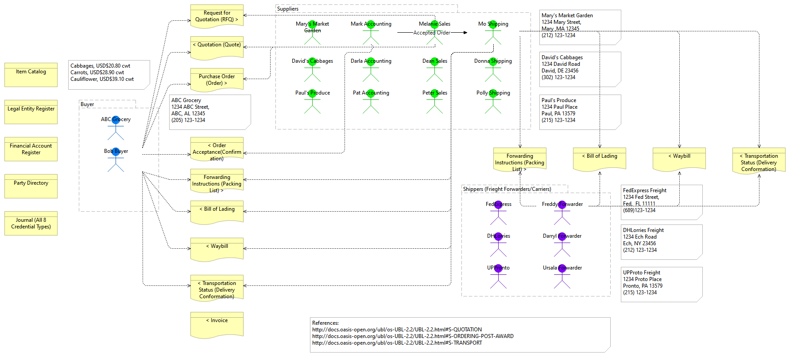
ENTITIES and Workflows

Slide 30
Demos
Prototype1 Goals
Create a DIDCOMM agent that accepts encrypted DIDCOMM messages
Model the message structures, DIDCOMM protocols, and server implementation using the Trinity Specification Language (TSL)
Use automatic code generation to build the message structures and server implementation using C#
Send an “empty” DIDCOMM message to the DIDCOMM Agent
Prototype 2 Goals
Use the Trinsic-id Okapi library to create an encrypted DIDCOMM message containing a (dummy) Verifiable Capability Authorization (VCA) resembling a Notify message in the VCTPS Protocol
Send the Notify VCTPS Protocol message (w/multiple recipients) to the Prototype 1 DIDCOMM agent
Have the DIDCOMM agent receive, accept, and decrypt the Notify message
Show a simple example of saving a Trinity structure (cell) to Trinity Local Storage

Slide 31
Demos
Prototype 5 Goals
Structured Credential Programming Model using TSL autogenerated entities (C# classes)
Model Verifiable Capability Authorization (VCA) using TSL (and VCA ACK)
Replace dummy VCA used in Prototype2 with the VCTPS Protocol model expressed using TSL
Create helper methods for VCAs (as well as VCAACKs and UBL Invoices, Parties, and Items)
Create a VCA VC

Slide 32
RESOURCES
Trinsic-id Okapi DID Libraries
GitHub: https://github.com/trinsic-id/okapi
Examples: https://github.com/trinsic-id/okapi/tree/main/dotnet/Tests/Okapi.Tests
Microsoft “Trinity” GraphEngine
GitHub: https://github.com/microsoft/GraphEngine
Documentation: https://www.graphengine.io/docs/manual/index.html
Examples: https://www.graphengine.io/docs/manual/DemoApps/index.html
DIDCOMM Super Stack (DIDSS)
Examples: https://github.com/mwherman2000/VCTPSPrototypes
Structured Credential Model
https://www.youtube.com/playlist?list=PLU-rWqHm5p45dzXF2LJZjuNVJrOUR6DaD

Slide 33
 Questions?
Michael Herman Trusted Digital Web PROJECT Hyperonomy Digital Identity Lab Parallelspace Corporation Alberta, CANADA
mwherman@parallelspace.net
DIDCOMM Super Stack - Hyperonomy Digital Identity Lab - Parallelspace Corporation
2023-04-08

